Slide 1

Advanced Java Programming Database Applications with JDBC
By
Ravi Kant Sahu
Asst. Professor
Lovely Professional University, Punjab

Slide 2
Outlines
Introduction
Relational Database System
JDBC
JDBC Architecture
JDBC Interfaces
Prepared Statements
Retrieving Metadata
Batch Processing

Slide 3
Introduction
Database System consists of :
1. A database
2. A software that stores and manages data in the database
3. Application programs that present the data and enable the user to interact with the database system.
Application User
System User
Application Programs
Database Management System
Database

Slide 4
Relational Database System
Based on Relational Data Model.
Key Components are:
1. Structure
2. Integrity
3. Language
Structure defines the representation of data.
Integrity imposes constraints on data.
Language provides means for accessing and manipulating the data.

Slide 5
Relational Structure
A Relation is a table consisting of non-duplicate rows.
A Row of a table represents a Record, and called as a Tuple.
A Column in a table represents an Attribute.

Slide 6
Integrity Constraints
An Integrity Constraint imposes a condition that all the legal values in a table must satisfy.
Three types of Constraints are:
1. Domain Constraint
2. Primary Key Constraints
3. Foreign Key Constraints

Slide 7
Integrity Constraints
Domain Constraints specify the permissible values for any attribute.
Primary Key Constraint: Primary Key is a minimal Super key, used to identify a tuple in the database.
Foreign Key Constraint: defines the relationship among relations (tables).
A set of attributes F is a foreign key in any relation R that references relation T if:
1. The attributes in F have the same domain as the primary key in T.
2. A non-null value on F in R must match a primary key value in T.

Slide 8
JDBC
JDBC stands for Java DataBase Connectivity.
JDBC is a standard Java API for database-independent connectivity between the Java programming language and a wide range of databases.
By using JDBC, a Java application can access any kind of tabular data, especially data stored in a Relational Database.
JDBC works with Java on a variety of platforms, such as Windows, Mac OS, and the various versions of UNIX.

Slide 9
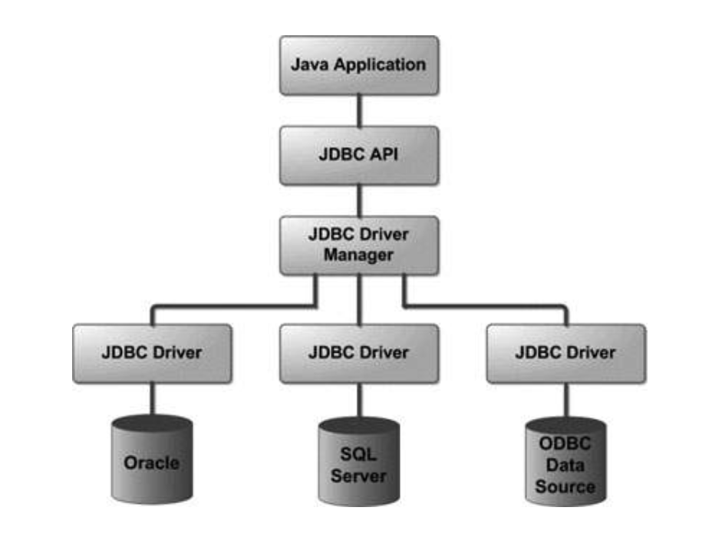
JDBC
A JDBC based application is insulated from the characteristics of specific database engines.

Slide 10
Problem with Database Packages
Different Vendors provided Database Packages with different APIs (functions defined for Application) in different Technologies.
The Problem with native drivers was that a programmer has to learn a new API for each Database and application needs to be modified if database package is changed.

Slide 11
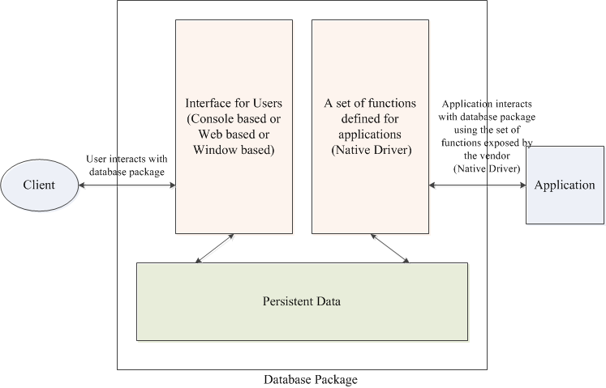
Database Packages and Application

Slide 12
ODBC
ODBC (Open DataBase Connectivity) provides the solution of that problem.
It is a common API that is supported by all databases.
ODBC represents function prototype in C.
From Microsoft, 1994
Quite easy to use (preferred in .Net)…

Slide 13
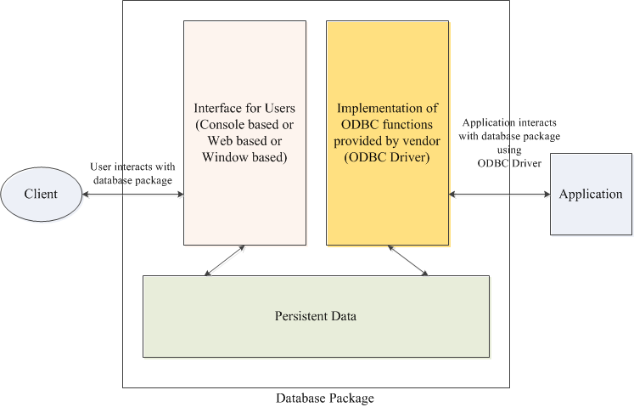
ODBC

Slide 14
JDBC Concepts
JDBC’s design is very similar to the design of ODBC.
Database vendors provide JDBC drivers for the database package.
JDBC helps in writing Java applications that manage these three programming activities:
Connect to a data source, like a database
Send queries and update statements to the database
Retrieve and process the results received from the database in answer to our query

Slide 15
JDBC Concepts
Driver Manager
Loads database drivers, and manages the connection between the application and the driver
Driver
Translates API calls into operations for a specific data source
Connection
A session between an application and a database

Slide 16
JDBC Concepts
Statement
An SQL Statement to perform a query or update operation
Metadata
Information about returned data, the database and the driver
ResultSet
Logical set of columns and rows returned by executing an SQL statement (resulting tuples)

Slide 17
Steps during Execution
The following steps are executed when running a JDBC application
Import the necessary classes
Load the JDBC driver
Identify the database source
Allocate a “connection” object (create)
Allocate a “Statement” object (create)
Execute a query using the “Statement” object
Retrieve data from the returned “ResultSet” object
Close the “ResultSet” object
Close the “Statement” object
Close the “Connection” object

Slide 18
JDBC Component Interaction
Driver
Manager
Creates
Creates
Creates
Connection
Statement
ResultSet
SQL
Driver
Establish
Link to DB
Result
(tuples)
Database

Slide 19
Steps Involved in Basic JDBC Operations
Driver Manager
1. Load the JDBC driver class:
Class.forName(“driverName”);
2. Open a database connection:
DriverManager.getConnection
(“jdbc:xxx:datasource”);
3. Issue SQL statements:
stmt = con.createStatement();
stmt.executeQuery (“Select * from myTable”);
4. Process resultset:
while (rs.next()) {
name = rs.getString(“name”);
amount = rs.getInt(“amt”); }
Driver
Connection
Database
Statement
Result Set

Slide 20
JDBC ARCHITECTURE

Slide 21
Two-Tier Database Access Model
Java Application talks directly to the database.
Accomplished through the JDBC driver which sends commands directly to the database.
Results sent back directly to the application
Application Space
Java Application
JDBC Driver
SQL
Command
Result
Set
Database

Slide 22
Three-Tier Database Access Model
JDBC driver sends commands to a middle tier, which in turn sends commands to database.
Results are sent back to the middle tier, which communicates them back to the application
Application Space
Java Application
JDBC Driver
SQL
Command
Result
Set
Application Server
(middle-tier)
Proprietary
Protocol
Database

Slide 23
JDBC DRIVERS

Slide 24
JDBC Driver Types
JDBC-ODBC Bridge, plus ODBC driver (Type 1)
JDBC methods -> Translate JDBC methods to ODBC methods -> ODBC to native methods -> Native methods API
Native-API, partly Java driver (Type 2)
JDBC methods -> Map JDBC methods to native methods (calls to vendor library) -> Native methods API (vendor library)
JDBC-Network driver (Type 3)
JDBC methods -> Translate to Native API methods through TCP/IP network -> Native API methods
Pure Java driver (Type 4)
Java methods -> Native methods in Java

Slide 25
Type 1: JDBC-ODBC Bridge
This driver type is provided by Sun with JDK
Provides JDBC access to databases through ODBC drivers
ODBC driver must be configured for the bridge to work
Only solution if no JDBC driver available for the DBMS
Application Space
Java Application
JDBC – ODBC Bridge
SQL
Command
Result
Set
ODBC Driver
Proprietary
Protocol
Database

Slide 26
Type 2: Native-API, Partly Java Driver
Native-API driver converts JDBC commands into DBMS-specific native calls
Directly interfaces with the database
Application Space
Java Application
Type 2 JDBC Driver
SQL
Command
Result
Set
Native Database
Library
Proprietary
Protocol
Database

Slide 27
Type 3: JDBC-Network Driver
Translates JDBC calls into a database-independent network protocol and sent to a middleware server.
This server translates this DBMS-independent protocol into a DBMS-specific protocol and sent to the database.
Results sent back to the middleware and routed to the client
Application Space
Java Application
Type 3 JDBC Driver
SQL
Command
Result
Set
Middleware Space
JDBC Driver
Proprietary
Protocol
Database

Slide 28
Type 4: Native-Protocol, Pure Java Driver
Pure Java drivers that communicate directly with the vendor’s database
JDBC commands converted to database engine’s native protocol directly
Advantage: no additional translation or middleware layer
Improves performance
Application Space
Java Application
Type 4 JDBC Driver
SQL Command Using Proprietary Protocol
Result Set Using Proprietary Protocol
Database

Slide 29
Driver Manager
The DriverManager class is responsible for establishing connections to the data sources, accessed through the JDBC drivers.
The driver can be loaded explicitly by calling the static method “forName” in the “Class” class and pass the driver argument
Class.forName(“sun.jdbc.odbc.JdbcOdbcDriver”);
The “forName()” method can throw a “ClassNotFoundException” if the driver class is not found. Hence, this function call should be in a try-catch block.

Slide 30
Connection Object
Connection object represents an established connection to a particular data source
A connection object can also be used to query the data source (data and metadata)
Different versions of getConnection() method contained in the DriverManager class that returns a connection object:
Connection con = DriverManager.getConnection(source);
Connection con = DriverManager.getConnection(source, u_name, pwd);

Slide 31
Statement Object
Used for creating an SQL query, execute it, and retrieve the results.
Statement objects are created by calling the createStatement() method of a valid connection object.
Executes SQL query by calling the executeQuery() method.
The SQL query string is passed as argument to the executeQuery() method
The result of executing the query is returned as an object of type “ResultSet”
Statement stmt = con.createStatement();
ResultSet myresults = stmt.executeQuery(“select * from authors”);

Slide 32
ResultSet Object
The results of executing an SQL query are returned in the form of an object that implements the ResultSet interface.
ResultSet object contains a “cursor” that points to a particular record (called the current record).
When the ResultSet object is created, the cursor points to the position immediately preceding the first record.
Several methods available to navigate the ResultSet by moving the cursor:
first(), last(), beforeFirst(), afterLast(), next(), previous(), etc. //returns true if the move is successful
isFirst() //whether you reached the beginning of the ResultSet
isLast() // whether you reached the end of the ResultSet

Slide 33
Accessing Data in a ResultSet
Methods for Retrieving Column Data:
getString(), getInt(), getShort(), getFloat(), getDouble(), getTime() etc.
We can always use getString() method for numerical values if we are not going to do some computations.
Column names are NOT case sensitive.
ResultSetMetaData object has metadata information about records, i.e., column names, data types etc.

Slide 34
Statement

Slide 35
Statement
Defines the methods and properties that enable us to send SQL or PL/SQL commands and receive data from database.
Statement: Useful when we are using static SQL statements at runtime.
-- The Statement interface cannot accept parameters.
PreparedStatement: Used when we plan to use the SQL statements many times.
-- The PreparedStatement interface accepts input parameters at runtime.
CallableStatement: Used when we want to access database stored procedures.
-- The CallableStatement interface can also accept runtime input parameters.

Slide 36
Statement Methods
boolean execute(String SQL): Returns a boolean value of true if a ResultSet object can be retrieved; otherwise, it returns false.
-- Use this method to execute SQL DDL statements.
int executeUpdate(String SQL): Returns the numbers of rows affected by the execution of the SQL statement.
-- Use this method to execute SQL statements for which you expect to get a number of rows affected - for example, an INSERT, UPDATE, or DELETE statement.
ResultSet executeQuery(String SQL): Returns a ResultSet object.
-- Use this method when you expect to get a result set, as you would with a SELECT statement.

Slide 37
PreparedStatement
The PreparedStatement interface extends the Statement interface.
PreparedStatement provides the facility of executing parameterized query.
prepareStatement() method of Connection interface is used to create a prepared Statement.
Statement pstmt = con.prepareStatement(“insert into Emp (id, name, age)” + “values (?, ?, ?)”);

Slide 38
PreparedStatement Methods
It also provides methods for setting the parameters in the preparedStatement object.
General method Signature:
setXXX (int parameterIndex, X value)
pstmt.setInt (1, 30)
pstmt.setString (2, “Ravi Kant”)
pstmt.setInt (3, 26)

Slide 39
CallableStatement
CallableStatement interface is used to execute SQL-stored procedures.
A CallableStatement object can be created using the prepareCall (String call) method.
CallableStatement cstmt = con.prepareCall
(“{call sampleProcedure(?, ?, ?)}”);
CallableStatement for a function:
CallableStatement cstmt = con.prepareCall
(“{? = call sampleProcedure(?, ?, ?)}”);

Slide 40
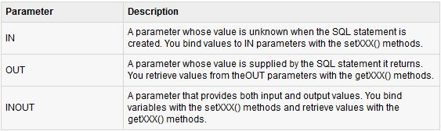
StoredProcedure
create or replace procedure sampleProcedure
(p1 in varchar, p2 out number, p3 in out integer) is
begin
-- do something
end sampleProcedure;
Parameters: PreparedStatement uses only IN parameter, while CallableStatement uses all three.

Slide 41
CallableStatement Methods
Setting IN Parameter:
setXXX (int parameterIndex, X value)
cstmt.setInt (1, 30)
cstmt.setString (2, “Ravi Kant”)
Setting OUT Parameter:
registerOutParameter (int parameterIndex, Types.XXX)
-- Types.INTEGER, Types.DOUBLE etc
cstmt.registerOutParameter (3, Types.INTEGER);

Slide 42
Resultset

Slide 43
ResultSet
A ResultSet object maintains a cursor pointing to its current row of data.
Initially the cursor is positioned before the first row.
The next method moves the cursor to the next row, and returns false when there are no more rows in the ResultSet object.
A default ResultSet object is not updatable and has a cursor that moves forward only.

Slide 44
Scrollable and Updateable Resultset
With the new versions of JDBC, we can scroll the rows both forward and backward and move the cursor to a desired location using the first(), last(), next(), previous(), absolute(), or relative() method.
We can insert, delete, or update a row in the result set and have the changes automatically reflected in the database.
To obtain a scrollable or updatable result set, first create a statement with an appropriate type and concurrency mode.

Slide 45
Scrollable and Updateable Resultset
For static statement,
Statement statement = connection.createStatement (
int resultSetType,
int resultSetConcurrency);
For a prepared statement,
PreparedStatement statement = connection.prepareStatement(
String sql,
int resultSetType,
int resultSetConcurrency);

Slide 46
Scrollable Resultset
The possible values of resultSetType are the constants defined in the
ResultSet:
TYPE_FORWARD_ONLY: The result set is accessed forward sequentially.
TYPE_SCROLL_INSENSITIVE: The result set is scrollable, but not sensitive to changes in the database.
TYPE_SCROLL_SENSITIVE: The result set is scrollable and sensitive to changes made by others.
Use this type if you want the result set to be scrollable and updatable.

Slide 47
Updateable Resultset
The possible values of resultSetConcurrency are the constants defined in
the ResultSet:
CONCUR_READ_ONLY: The result set cannot be used to update the database.
CONCUR_UPDATABLE: The result set can be used to update the
database.
For example, scrollable and updatable resultset can be created as follows:
Statement statement = connection.createStatement (ResultSet.TYPE_SCROLL_SENSITIVE, ResultSet.CONCUR_UPDATABLE)

Slide 48
Retrieving MetaData

Slide 49
MetaData
JDBC provides two interfaces for obtaining metadata.
DatabaseMetaData interface for obtaining database information.
ResultSetMetaData interface for obtaining information of specific ResultSet (e.g. column count and column names).
getMetaData() method is used to obtain the metadata.

Slide 50
DatabaseMetaData
Following methods can be used to obtain database metadata:
1. getUserName()
2. getURL()
3. getDatabaseProductName()
4. getDatabaseProductVersion()
5. getDriverName()
6. getDriverVersion()
7. getDriverMajorVersion()
8. getDriverMinorVersion()
9. getMaxConnections()
10. getMaxTableNameLength()
11. getMaxColumnsInTable()

Slide 51
ResultSetMetaData
It provides the following methods:
1. getColumnName(int) method to find the column names.
2. getColumnCount() method to find the number of columns in the resultset.
3. getColumnType(int)

Slide 52
Batch Processing

Slide 53
Batch Processing
Batch Processing allows to group related SQL statements into a batch and submit them with one call to the database.
When we send several SQL statements to the database at once, it overhead, thereby improving performance. reduces the amount of communication.
DatabaseMetaData.supportsBatchUpdates() method is used to determine if the target database supports batch update processing.
The method returns true if JDBC driver supports this feature.

Slide 54
Methods for Batch Processing
The addBatch() method is used to add individual statements to the batch.
The executeBatch() is used to start the execution of all the statements grouped together.
The executeBatch() returns an array of integers, and each element of the array represents the update count for the respective update statement.
The clearBatch() method is used to remove all the statements added with the addBatch() method.
We can not selectively choose which statement to remove.

Slide 55
Steps to use Batch Processing
Create a Statement object using createStatement() methods.
Set auto-commit to false using setAutoCommit().
Add as many as SQL statements you like into batch using addBatch() method on created statement object.
Execute all the SQL statements using executeBatch() method on created statement object.
Finally, commit all the changes using commit() method.

Slide 56
Example
// Create statement object
Statement stmt = conn.createStatement();
// Set auto-commit to false
conn.setAutoCommit(false);
// Create some SQL statements and add them in the batch
String SQL1 = "INSERT INTO Emp (id, name, age) " + "VALUES(1,‘Ravi’, 25)";
stmt.addBatch(SQL1);
String SQL2 = "INSERT INTO Emp (id, name, age) " + "VALUES(200,'Raj', 30)";
stmt.addBatch(SQL2);
String SQL3 = "UPDATE Emp SET age = 35 " + "WHERE id = 100";
stmt.addBatch(SQL3);
// Create an int[] to hold returned values
int[] count = stmt.executeBatch();
//Explicitly commit statements to apply changes
conn.commit();

Slide 57
Brainstorming
What will happen when you:
try to add a SELECT query into the batch?
don’t call con.setAutoCommit(false);?
call setAutoCommit(false) but don’t call commit()?

Slide 58
Developing JDBC Programs
Statement to load a driver:
Class.forName("JDBCDriverClass");
A driver is a class. For example:
Database Driver Class Source
Access sun.jdbc.odbc.JdbcOdbcDriver Already in JDK
MySQL com.mysql.jdbc.Driver Website
Oracle oracle.jdbc.driver.OracleDriver Website
The JDBC-ODBC driver for Access is bundled in JDK.
MySQL driver class is in mysqljdbc.jar
Oracle driver class is in classes12.jar
Loading drivers
Establishing connections
Creating and executing statements
Processing ResultSet

Slide 59
Developing JDBC Programs
Connection connection = DriverManager.getConnection(databaseURL);
Database URL Pattern
Access jdbc:odbc:dataSource
MySQL jdbc:mysql://hostname/dbname
Oracle jdbc:oracle:thin:@hostname:port#:oracleDBSID
Examples:
For Access:
Connection connection = DriverManager.getConnection
("jdbc:odbc:ExampleMDBDataSource");
For MySQL:
Connection connection = DriverManager.getConnection
("jdbc:mysql://localhost/test");
For Oracle:
Connection connection = DriverManager.getConnection
("jdbc:oracle:thin:@liang.armstrong.edu:1521:orcl", "scott", "tiger");
Loading drivers
Establishing connections
Creating and executing statements
Processing ResultSet

Slide 60
Developing JDBC Programs
Creating statement:
Statement statement = connection.createStatement();
Executing statement (for update, delete, insert):
statement.executeUpdate
("create table Temp (col1 char(5), col2 char(5))");
Executing statement (for select):
// Select the columns from the Student table
ResultSet resultSet = statement.executeQuery
("select firstName, mi, lastName from Student where lastName " + " = 'Smith'");
Loading drivers
Establishing connections
Creating and executing statements
Processing ResultSet

Slide 61
Developing JDBC Programs
Executing statement (for select):
// Select the columns from the Student table
ResultSet resultSet = stmt.executeQuery
("select firstName, mi, lastName from Student where lastName "
+ " = 'Smith'");
Processing ResultSet (for select):
// Iterate through the result and print the student names
while (resultSet.next())
System.out.println(resultSet.getString(1) + " " + resultSet.getString(2)
+ ". " + resultSet.getString(3));
Loading drivers
Establishing connections
Creating and executing statements
Processing ResultSet

Slide 62
JDBC connectivity with Oracle
Oracle JDBC Thin Driver Format:
jdbc:oracle:thin:@<host>:<port>:<SID>
jdbc:oracle:thin:@//<host>:<port>/<service_name>
Example:
jdbc:oracle:thin:192.168.2.1:1521:X01A
jdbc:oracle:thin:@//192.168.2.1:1521/XE
The Oracle System ID (SID) is used to uniquely identify a particular database on a system. For this reason, one cannot have more than one database with the same SID on a computer system.
Note: Support for SID is being phased out.
Oracle recommends that users switch over to using service names.

Slide 63


